Slide 1
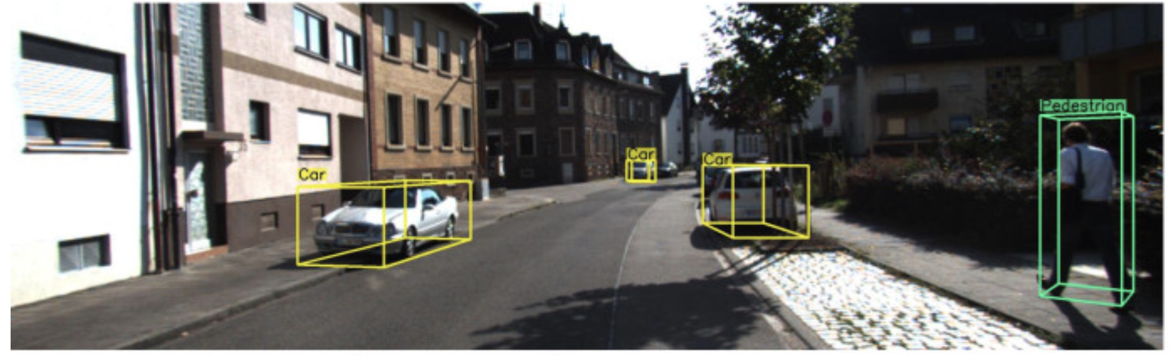

3D Object Detection For Self-Driving Cars
solution
introduction
problem
data
references
analysis
contents
conclusion
Burak Çolakoğlu 201611012 Furkan Han Keçeli 201611037 Advisor: Faris Serdar Taşel Co-Advisor: Roya Choupani

Slide 2
Introduction
Analysis
Data
solution
introduction
Problem
problem
data
references
analysis
contents
conclusion
Solution
Conclusion
References

Slide 3
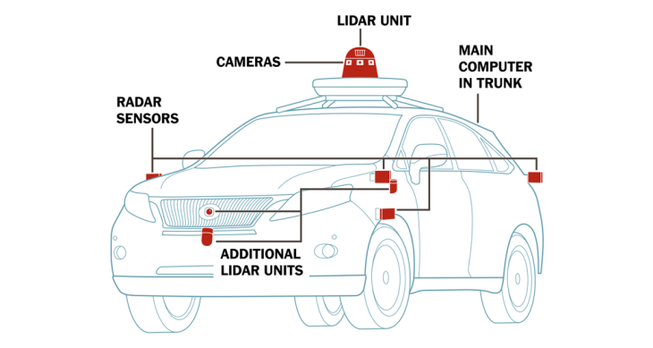
Perception
Object detection is one of perception task which is classify and identify the objects around the autonomous vehicle. Currently, there are 4 main exteroceptive sensor technologies, those are; Camera, LiDAR, RADAR and SONAR. Among these sensors, Cameras and LiDAR’s are more important primarily rather than RADAR and SONAR. Since, RADAR sensors are providing longer observing range in large objects, and SONAR sensors measure short-range objects by using sound-waves.
solution
introduction
problem
data
references
analysis
contents
conclusion

Slide 4
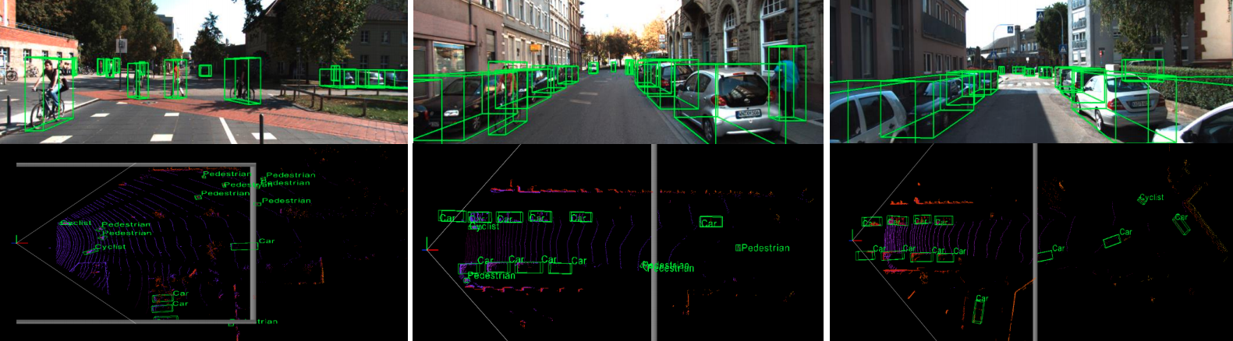
We have researched academic papers related to our research project topic. These are; Real-time object detection, Sparse Voxel-Graph for 3D Object Detection from Point Clouds and Multi-column Deep Neural Networks for Image Classification.
introduction
solution
analysis
problem
references
data
contents
conclusion

Slide 5
 | Pros | Cons
2D | -Convolutional Neural Networks are perform well over 3D data. -Less computation power rather than 3D data. -Less cost to equip the ego vehicle. - Able to collect RGB information. | - It can effect heavy sunlight improperly. - Depth information is not available.
3D | -LiDAR sensors are capable to scan the 3D map(360-degree) of the environment of the ego vehicle. -It is able to give rapid response ( < 100ms&360-degree scan). - Usually better performance than 2D - It works well both in daylight and nightlight. | -It is unreliable in heavy rains . - LiDAR collects massive and complex data which require comprehensive data analyze skill.
introduction
solution
analysis
problem
references
data
contents
conclusion

Slide 6
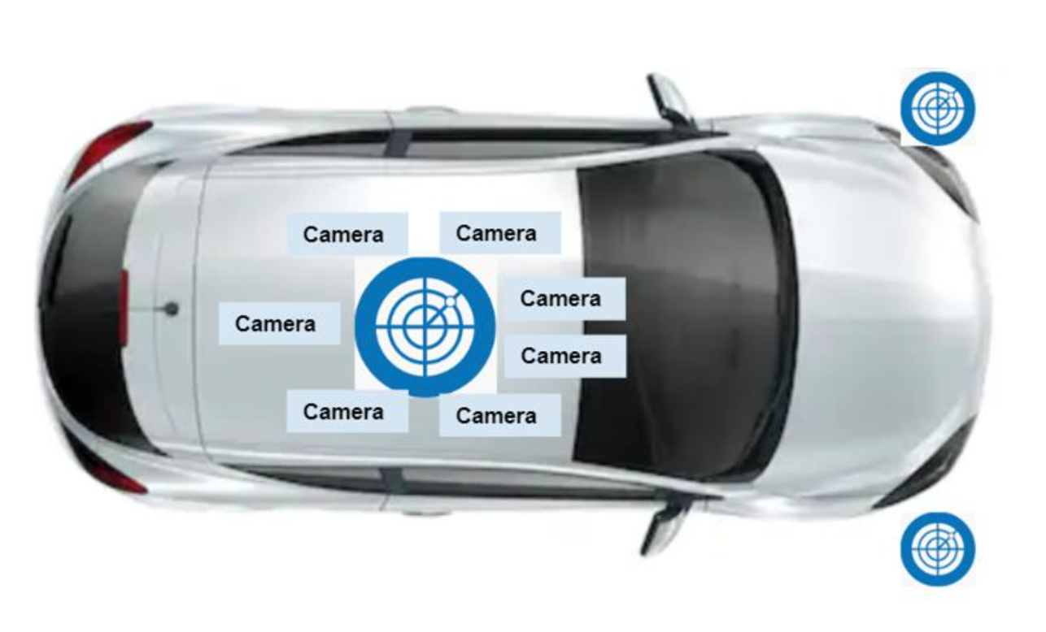
Data collected by 10 host cars
Images are captured with 7 cameras
LIDAR data captured by 3 sensors. One sensor at the top of the car and two sensors at the front, under the lights.
introduction
data
solution
analysis
references
problem
contents
conclusion

Slide 7
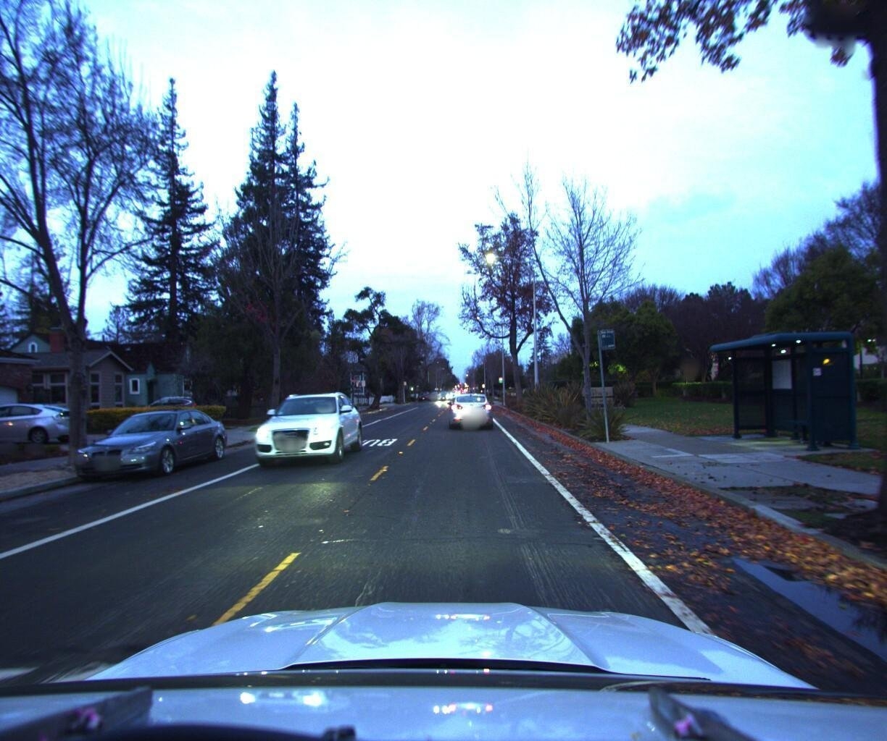
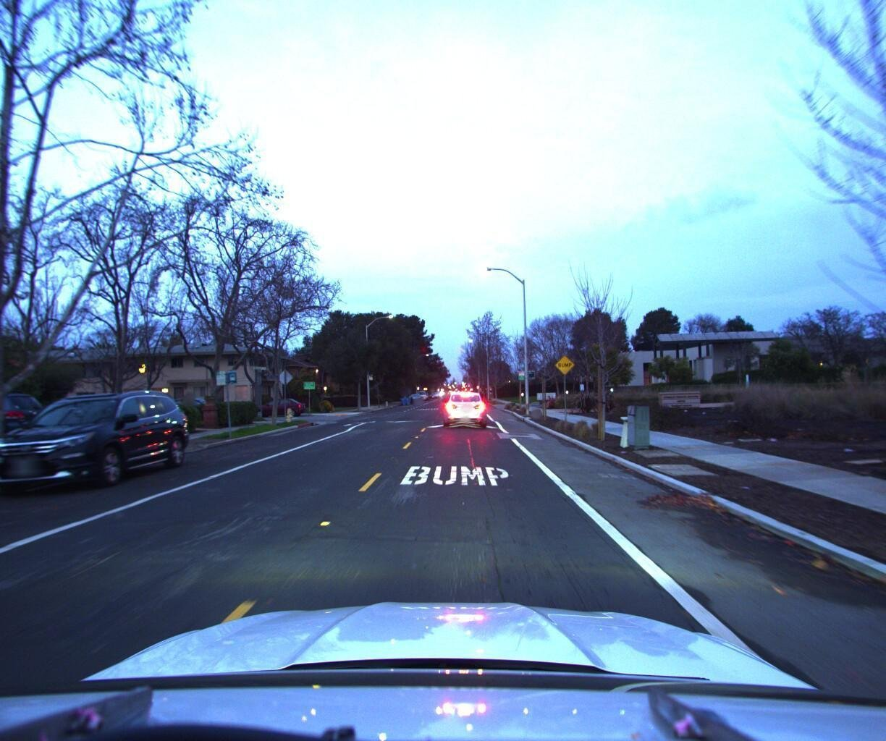
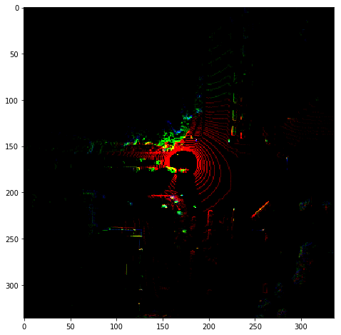
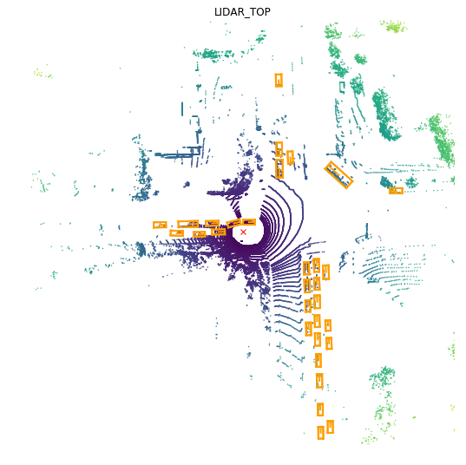
117 GB DATA
192.276
158.757
30.744
27.468
introduction
data
solution
analysis
references
problem
Camera Data
Camera Data
LIDAR Data
LIDAR Data
contents
conclusion
For Test Set
For Training Set
For Test Set
For Training Set

Slide 8
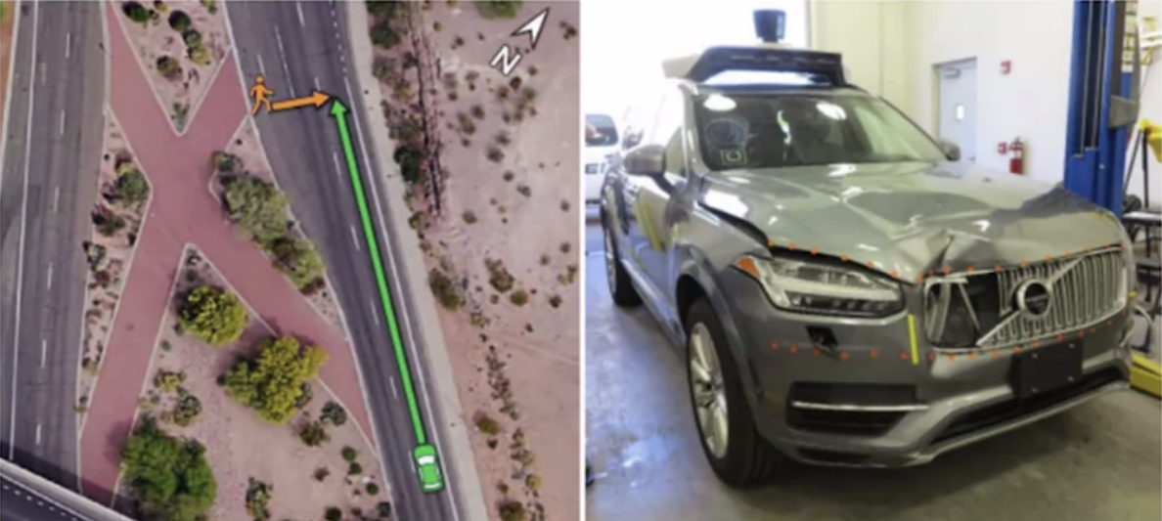
To make realize self-driving cars into roads, and make them alternative to human based driving, there are some certain issues to be solved.
In 2018, Uber’s self-driving car crash led to a pedestrian fatality. There was significant confusion in the software detection system.
problem
introduction
data
solution
analysis
references
contents
conclusion

Slide 9
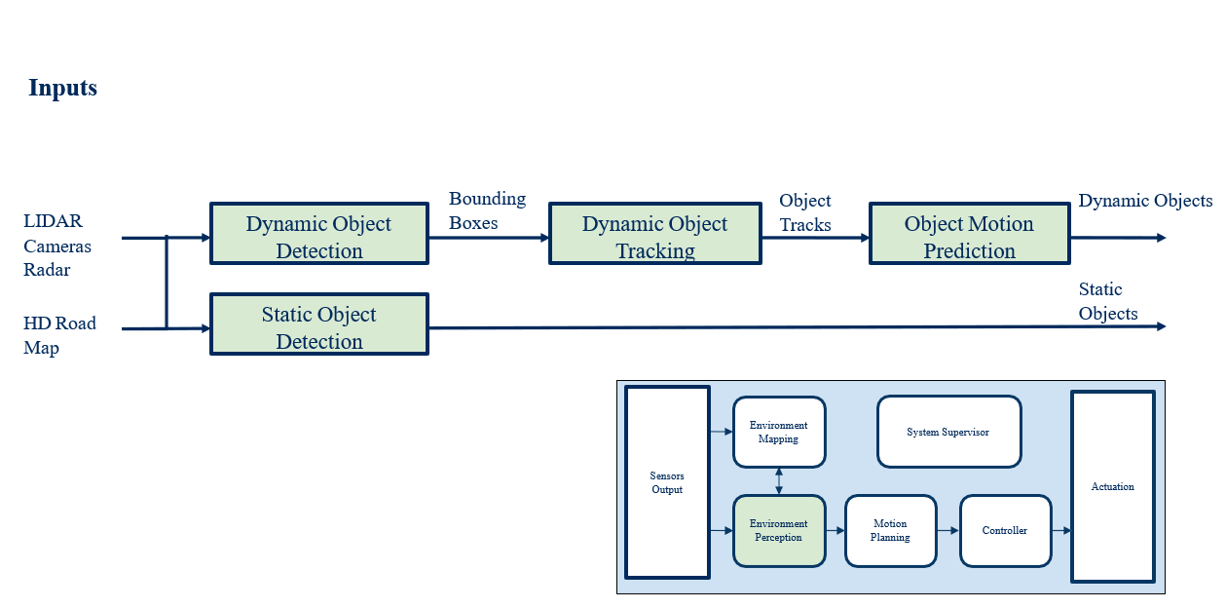
Environment Perception
solution
introduction
problem
data
analysis
references
contents
conclusion

Slide 10






We are planning to approach to the 3D dataset with VoxelNet which is provide both bound boxing and feature extraction from point clouds. For 2D dataset, Fast R-CNN, Faster R-CNN and R-CNN will be applied.
Technologies Used
solution
introduction
problem
data
analysis
references
contents
conclusion

Slide 11
At the end of this project, we will optimize the object detection algorithm for self-driving cars by working with 117 GB of data, and we will enable it to accurately detect objects such as pedestrians, cyclists, obstacles, moving cars and parked cars in a short time.
introduction
solution
analysis
problem
references
conclusion
data
contents

Slide 12
[1] https://www.kaggle.com/c/3d-object-detection-for-autonomous-vehicles [2] Deep SCNN-based Real-time Object Detection for Self-driving Vehicles Using LiDAR Temporal Data [3] Multi-column Deep Neural Networks for Image Classification [4] SVGA-Net: Sparse Voxel-Graph Attention Network for 3D Object Detection from Point Clouds
[5] https://pythonawesome.com/stereo-r-cnn-based-3d-object-detection-for-autonomous-driving/
introduction
solution
analysis
problem
conclusion
data
contents
references

Slide 13
Thank You For Listening
Any Questions?

